Slide 1


VISVESVARAYA TECHNOLOGICAL UNIVERSITY,
Jnana Sangama, Belagavi -590014
A DBMS MINI PROJECT REPORT ON
“QR CODE ATTENDANCE MANAGEMENT SYSTEM”
IN
COMPUTER SCIENCE & ENGINEERING
By
HARSHA H CHANDANA B N B BHARGAVI LAKSHMI L
1DB23CS037
1DB23CS021
1DB24CS072
1DB24CS056
Under the Guidance of Ms. SINCHANA K P B.E, M. TECH
Assistant Professor Department of CSE, DBIT
DON BOSCO INSTITUTE OF TECHNOLOGY
(An Autonomous Institution, affiliated to VTU, Belagavi) DEPARTMENT OF COMPUTER SCIENCE & ENGINEERING
BENGALURU – 560074, KARNATAKA 2025 – 2026

Slide 2
DON BOSCO INSTITUTE OF TECHNOLOGY
(An Autonomous Institution, affiliated to VTU, Belagavi)
BENGALURU – 560074, KARNATAKA DEPARTMENT OF COMPUTER SCIENCE & ENGINEERING
CERTIFICATE
This is to certify that the Mini Project entitled “QR CODE ATTENDANCE MANAGEMENT SYSTEM” has been successfully completed by
HARSHA H CHANDANA B N B BHARGAVI LAKSHMI L
1DB23CS037
1DB23CS021
1DB24CS072
1DB24CS056
the Bonafide students of Department of Computer Science & Engineering, Don Bosco Institute of Technology of the Visvesvaraya Technological University, Belagavi, during the year 2025–2026. It is certified that all corrections/suggestions indicated for Internal Assessment have been incorporated in the report deposited in the departmental library. The Mini project report has been approved as it satisfies the academic requirements in respect of Mini Project work prescribed for the Bachelor of Engineering Degree.
Ms. SINCHANA K P
BE, M. TECH
Mini Project Guide
Dr K B SHIVAKUMAR
B.E, M.E, M.B.A, M.Phil., Ph.D.
HOD
External Viva
Name of the Examiners
Signature with Date
1.
2.

Slide 3
DON BOSCO INSTITUTE OF TECHNOLOGY
(An Autonomous Institution, affiliated to VTU, Belagavi)
BENGALURU – 560074, KARNATAKA DEPARTMENT OF COMPUTER SCIENCE & ENGINEERING
Declaration
We, HARSHA H, CHANDANA B, N B BHARGAVI, LAKSHMI L hereby declare that the dissertation entitled, QR CODE ATTENDANCE MANAGEMENT SYSTEM is completed and written by us under the supervision of my guide Ms. Sinchana K P, Assistant Professor, Department of Computer Science and Engineering, Don Bosco Institute of Technology, Bengaluru, of the Visvesvaraya Technological University, Belagavi, during the academic year 2025-2026. The dissertation report is original and it has not been submitted for any other degree in any university.
HARSHA H CHANDANA B N B BHARGAVI LAKSHMI L
1DB23CS037
1DB23CS021
1DB24CS072
1DB24CS054

Slide 4
ACKNOWLEDGEMENT
The satisfaction and euphoria that accompany a successful completion of any task would be incomplete without the mention of people who made it possible, success is the epitome of hard work and perseverance, but steadfast of all is encouraging guidance.
So, with gratitude we acknowledge all those whose guidance and encouragement served as beacon of light and crowned the effort with success.
The selection of this mini project work as well as the timely completion is mainly due to the interest and persuasion of our mini project coordinator Ms. Sinchana K P, Assistant Professor, Department of Computer Science & Engineering. We will remember his contribution for ever.
We sincerely thank, Dr. K B ShivaKumar, Professor and Head, Department of Computer Science & Engineering who has been the constant driving force behind the completion of the project.
We thank our beloved Principal Dr. B S Nagabhushana, for his constant help and support throughout.
We are indebted to Management of Don Bosco Institute of Technology, Bengaluru
for providing an environment which helped us in completing our mini project.
Also, we thank all the teaching and non-teaching staff of Department of Computer Science & Engineering for the help rendered.
HARSHA H CHANDANA B N B BHARGAVI LAKSHMI L
1DB23CS037
1DB23CS021
1DB24CS072
1DB24CS054

Slide 5
ABSTRACT
The QR Attendance Management System is a smart and efficient solution developed to automate the process of attendance tracking in educational institutions and organizations. Traditional attendance methods are time-consuming, prone to human error, and difficult to manage, especially when handling large numbers of students or employees. This project uses QR code technology to simplify and digitize the attendance process.In this system, a unique QR code is generated for each class or session. Students or employees scan the QR code using a mobile device or scanner, and their attendance is automatically recorded in the database along with the date and time. The system provides fast, accurate, and secure attendance management while reducing paperwork and manual effort.The project includes modules such as student management, QR code generation, attendance recording, report generation, and admin login. The database is designed to store and manage attendance records efficiently, enabling quick retrieval of information and easy monitoring by administrators or faculty members.

Slide 6
TABLE OF CONTENTS
PAGE NO.
CHAPTER
DESCRIPTIONS
NO.
 | DECLARATION | i
 | ACKNOWLEDGEMENT……………………………………………............ ABSTRACT……………………………………………………………………. LIST OF FIGURES………………………………………………………….... | ii iii iv
1 | INTRODUCTION
 | 1.1 AIM | 1
 | 1.2 PROBLEM STATEMENT | 1
 | 1.3 MOTIVATION AND OBJECTIVES OF THE PROJECT | 1-2
 | 1.4 PROPOSED SOLUTION & ADVANTAGES | 2
2. | SYSTEM DESIGN
 | 2.1 SCHEMA DIAGRAM 2.2 ER DIAGRAM | 3 4
3 | IMPLEMENTATION
3.1 LANGUAGE USED FOR IMPLEMENTATION
3.2 PLATFORM USED FOR IMPLEMENTATION
3.3 SNAPSHOTS
5
5-26
27-30
4
CONCLUSION AND FUTURE ENHANCEMENT
4.1 CONCLUSION
4.2 FUTURE ENHANCEMENTS
31
31
REFERENCES ................................................................................... 32

Slide 7
LIST OF FIGURES
Fig No. | Fig Name | Pg No.
Fig 2.1 | Schema Diagram | 3
Fig 3.16 | Admin portal | 27
Fig 3.17 | Admin control panel | 27
Fig 3.18 | Attendance board | 28
Fig 3.19 | Class generator | 28
Fig 3.20 | Registration list | 29
Fig 3.21 | Attendance ledger | 29
Fig 3.22 | Identity confirmation | 30

Slide 8
TOUR GUIDE AND ADVENTURE TOURER
B24CSL49
CHAPTER 1
INTRODUCTION
1.1 INTRODUCTION
The "Adventure Booker" is a web-based database application designed to streamline and automate the process of planning, exploring, and booking adventure travel experiences. In the modern tourism industry, travelers increasingly seek unique, thrill-based activities such as trekking, scuba diving, paragliding, and wildlife safaris. However, traditional travel platforms often lack specialized management systems tailored to the dynamic logistics of adventure sports The primary objective of this project is to replace traditional, fragmented booking methods with a centralized, user-friendly, and highly secure online platform. Built on a robust relational database management system (RDBMS) backend, the Adventure Booker application provides a seamless data flow between thrill-seekers and adventure coordinators. It efficiently handles intricate data relations involving user profiles, adventure packages, dynamic pricing, real-time slot availability, tour guide allocations, and secure booking transactions By implementing structured database constraints, primary keys, and foreign keys, the system ensures high data integrity, eliminates redundancy, and optimizes query performance. Ultimately, the Adventure Booker system reduces administrative overhead, prevents overbooking, and provides users with an efficient, reliable, and transparent platform to organize their next adventure.
The main aim of the project is to develop an online adventure tour booking system called Adventure Booker that helps users explore, book and manage adventure tours easily through a web application.
The system allows:
-> Guides/Admins to add adventure packages
-> Adventurers to view and book tours
-> Users to make payments online
-> Easy management of bookings and tours

Slide 9
TOUR GUIDE AND ADVENTURE TOURER
B24CSL49
1.2 PROBLEM STATEMENT
Traditional adventure tour booking methods are mostly manual and time-consuming.
Customers face difficulties in:
Finding suitable adventure packages Comparing tour details
Booking tours quickly
Managing payments and bookings Tour guides also face problems in:
Managing tour information Updating tour packages
Maintaining booking records manually Hence, an online centralized system is required to simplify
adventure tour management and booking operations.
1.3 MOTIVATION AND OBJECTIVES OF THE PROJECT
->The objectives of the Adventure Booker project are:
->To create an online platform for adventure tour booking.
->To provide user registration and login facilities.
->To allow guides/admins to add and manage adventure tours.
->To display tour details including:
->Tour Name
->Location
->Price
->Duration
->Description
->Images
->To allow adventurers to:
->View tours
->Book tours

Slide 10
TOUR GUIDE AND ADVENTURE TOURER
->Make payments
->View booked tours
->To maintain booking and payment records efficiently using a database.
->To provide a user-friendly and attractive interface.
B24CSL49
Limitations:
->Limited Scalability
The system is designed for academic/mini-project use, so it may not handle a large number of users or bookings efficiently like a real-world travel platform.
->Basic User Interface
The UI is simple and may not be very attractive or user-friendly compared to professional booking websites
1.4 PROPOSED SOLUTIONS AND ADVANTAGES
The Adventure Booker system is designed to solve common problems in manual or traditional booking systems. The proposed solutions are:
->Digital Booking System
Replaces manual booking processes with an online system Reduces paperwork and human errors
->Centralized Database Management
All user details, adventure packages, and bookings are stored in a single database Ensures easy access and better data management
->Faster Booking Process
Users can view and book adventure packages instantly through the website Saves time compared to offline booking methods
->User-Friendly Interface
Simple and easy-to-use web pages for users to register, login, and book packages

Slide 11
TOUR GUIDE AND ADVENTURE TOURER B24CSL49
->Admin Control Panel
Admin can manage packages, users, and bookings efficiently from one place
->Improved Data Accuracy
Automated data handling reduces duplication and inconsistencies in records
->Better Accessibility
System can be accessed anytime through a local server or hosting environment
->Secure Login System
Ensures that only registered users and authorized admins can access the system
->Scalable Design (Future Improvement)
Can be expanded later to include payments, reviews, and real-time adventure updates

Slide 12
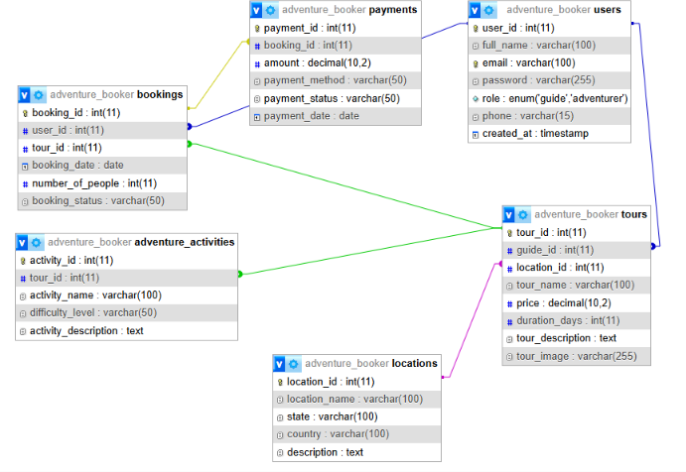
TOUR GUIDE AND ADVENTURE TOURER
B24CSL49
CHAPTER 2
SYSTEM DESIGN
2.1 SCHEMA DIAGRAM
Fig.2.1 Schema Diagram

Slide 13
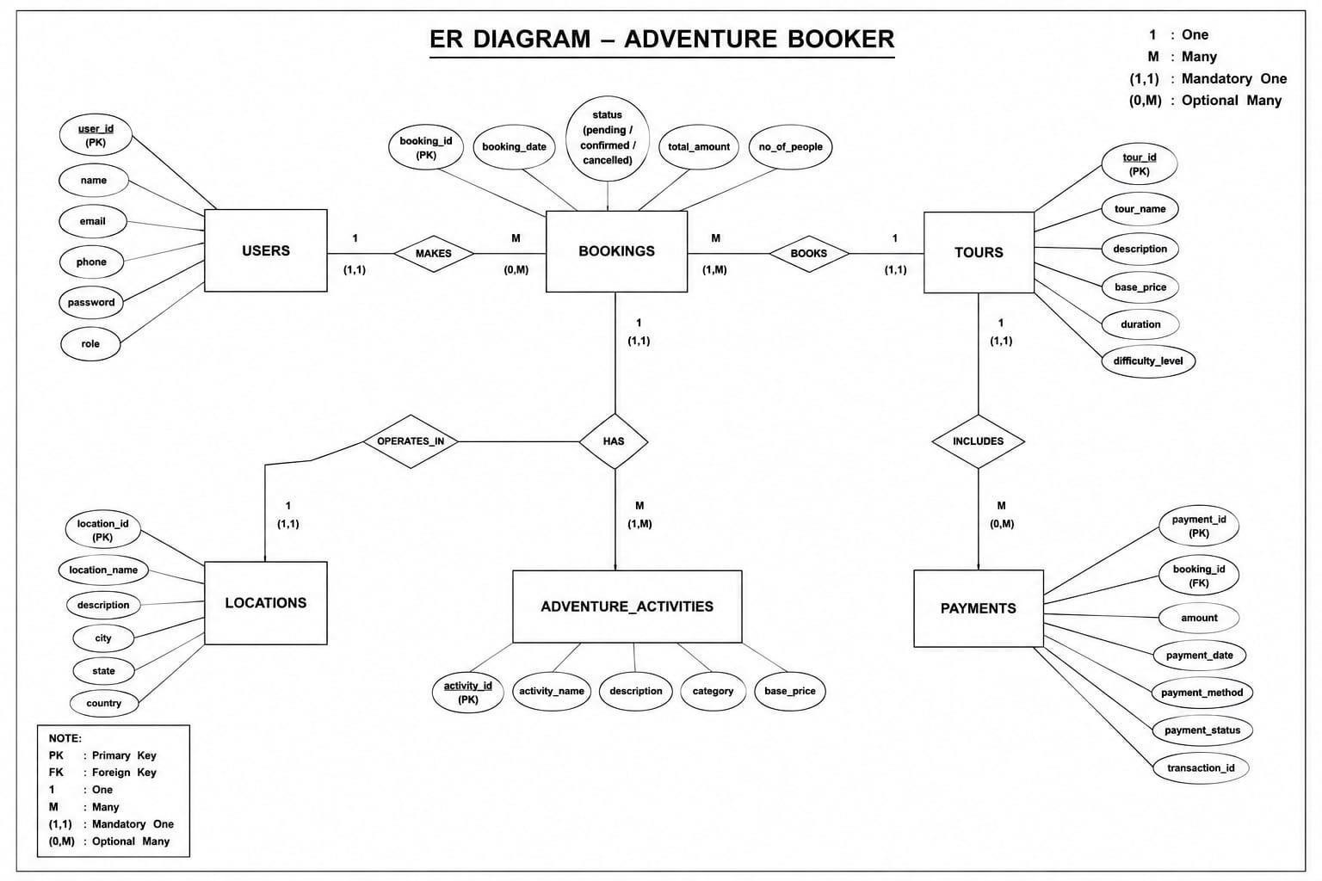
TOUR GUIDE AND ADVENTURE TOURER
B24CSL49
2.2 ER DIAGRAM
Fig.2.2 ER Diagram

Slide 14
TOUR GUIDE AND ADVENTURE TOURER
B24CSL49
CHAPTER 3
IMPLEMENTATION
LANGUAGE USED FOR IMPLEMENTATION
HTML & CSS: Builds the front-end structure and visual styling for your adventure booking forms, destination cards, and user dashboards.
JavaScript: Adds interactive features, such as dynamic form validation (e.g., ensuring travel dates are valid), pop-up alerts for successful bookings, and asynchronous API calls (AJAX) so pages don't need to reload when data is submitted.
PHP: Acts as the backend scripting language that processes user input, applies business logic (e.g., calculating total trip costs), and safely communicates with your database.
SQL: The structured query language used to manage, define, and retrieve data. You will use SQL to create tables for Adventures, Bookings, and Users.
PLATFORM FOR IMPLEMENTATION
Database (RDBMS): MySQL / MariaDB (Store destinations, bookings, users, and pricing).
Database Manager: phpMyAdmin (Accessed via XAMPP to create schemas, write SQL queries, and manage tables).
Server: Apache (Included in XAMPP to host your website locally).
Back-End Scripting: PHP (To connect your HTML web forms to your SQL database to handle login, booking, and cancellation operations).
Front-End: HTML, CSS, and JavaScript.

Slide 15
TOUR GUIDE AND ADVENTURE TOURER
B24CSL49
3.3 SQL COMMANDS AND QUERIES
SQL command for creating tables:
CREATE DATABASE adventure_booker;
USE adventure_booker;
CREATE TABLE users (
user_id INT AUTO_INCREMENT PRIMARY KEY,
full_name VARCHAR(100) NOT NULL, email VARCHAR(100) UNIQUE NOT NULL, password VARCHAR(255) NOT NULL,
role ENUM('guide','adventurer') NOT NULL, phone VARCHAR(15),
created_at TIMESTAMP DEFAULT CURRENT_TIMESTAMP
);
CREATE TABLE locations (
location_id INT AUTO_INCREMENT PRIMARY KEY, location_name VARCHAR(100) NOT NULL,
state VARCHAR(100),
country VARCHAR(100), description TEXT
);

Slide 16
TOUR GUIDE AND ADVENTURE TOURER
B24CSL49
CREATE TABLE adventure_activities (
activity_id INT AUTO_INCREMENT PRIMARY KEY, tour_id INT,
activity_name VARCHAR(100) NOT NULL, difficulty_level VARCHAR(50), activity_description TEXT,
FOREIGN KEY (tour_id) REFERENCES tours(tour_id)
);
CREATE TABLE bookings (
booking_id INT AUTO_INCREMENT PRIMARY KEY,
user_id INT, tour_id INT,
booking_date DATE, number_of_people INT, booking_status VARCHAR(50),
FOREIGN KEY (user_id) REFERENCES users(user_id),
FOREIGN KEY (tour_id) REFERENCES tours(tour_id)
);

Slide 17
TOUR GUIDE AND ADVENTURE TOURER
B24CSL49
CREATE TABLE tours (
tour_id INT AUTO_INCREMENT PRIMARY KEY,
guide_id INT, location_id INT,
tour_name VARCHAR(100) NOT NULL, price DECIMAL(10,2),
duration_days INT, tour_description TEXT,
FOREIGN KEY (guide_id) REFERENCES users(user_id),
FOREIGN KEY (location_id) REFERENCES locations(location_id)
);
CREATE TABLE payments (
payment_id INT AUTO_INCREMENT PRIMARY KEY,
booking_id INT,
amount DECIMAL(10,2), payment_method VARCHAR(50), payment_status VARCHAR(50), payment_date DATE,
FOREIGN KEY (booking_id) REFERENCES bookings(booking_id)
);

Slide 18
TOUR GUIDE AND ADVENTURE TOURER
3.4 OUTPUT TESTING
1. Home Page
B24CSL49
The system successfully displays the homepage with available adventure tours and activities. Users can navigate through different sections such as login, registration, packages, and booking details.
User Registration
New users can register successfully by entering valid details.
Validation checks prevent duplicate email registrations and empty fields.
User Login
Registered users can log in using valid username/email and password. Invalid credentials display an appropriate error message.
Tour Management
Admin can add, update, and delete adventure tour packages successfully.
Tour details such as location, price, duration, and activity type are displayed correctly.
Booking Module
Users can book adventure packages successfully.
Booking details are stored in the database with booking ID, user ID, and payment status.
Payment Module
Payment records are generated correctly after successful booking. Payment status updates properly as paid/unpaid.
Database Connectivity
The PHP application connects successfully with the MySQL database using XAMPP. All CRUD operations (Create, Read, Update, Delete) execute without errors.
Output Screens Successfully Tested
Registration Page Login Page Dashboard
Tour Package List
Booking Confirmation Page Payment Details Page Admin Management Panel

Slide 19
TOUR GUIDE AND ADVENTURE TOURER
B24CSL49
To connect the Database:
<?php
$host = "localhost";
$user = "root";
$password = "";
$database = "adventure_booker";
$conn = mysqli_connect(
$host,
$user,
$password,
$database
);
if(!$conn){ die(
"Database Connection Failed "
. mysqli_connect_error()
);
}
mysqli_set_charset($conn,"utf8");
?>

Slide 20
TOUR GUIDE AND ADVENTURE TOURER
B24CSL49
REGISTER PAGE:
<?php session_start();
include 'includes/db.php'; if(isset($_POST['register'])){
$name = $_POST['full_name'];
$email = $_POST['email'];
$password = $_POST['password'];
$role = $_POST['role'];
/* CHECK EMAIL */
$check = "SELECT * FROM users WHERE email='$email'";
$result = mysqli_query($conn,$check); if(mysqli_num_rows($result) > 0){
echo "<script>
alert('Email already registered');
</script>";
} else {
$sql = "INSERT INTO users (
full_name, email, password, role
)
VALUES (
'$name',
'$email',

Slide 21
TOUR GUIDE AND ADVENTURE TOURER
B24CSL49
'$password', '$role'
)";
if(mysqli_query($conn,$sql)){ header("Location: login.php"); exit();
} else {
echo "Registration Failed";
}
}
}
?>
<!DOCTYPE html>
<html>
<head>
<title>Register</title>
<meta charset="UTF-8">
<meta name="viewport"
content="width=device-width, initial-scale=1.0">
<link rel="stylesheet" href="css/style.css">
<style>
*{
margin:0; padding:0;
box-sizing:border-box;
}
body{
font-family:Arial, sans-serif; height:100vh;
display:flex;

Slide 22
TOUR GUIDE AND ADVENTURE TOURER
B24CSL49
justify-content:center; align-items:center; background:
linear-gradient(
135deg, #dbeafe, #bfdbfe, #93c5fd
);
}
.register-container{ width:950px; height:580px; display:flex;
border-radius:25px; overflow:hidden;
box-shadow:0 10px 30px rgba(0,0,0,0.2); background:white;
}
/* LEFT SIDE */
.left-panel{ width:50%; background:
linear-gradient( 135deg, #2563eb,
#1e40af, #0f172a
);
color:white; display:flex;

Slide 23
TOUR GUIDE AND ADVENTURE TOURER
B24CSL49
flex-direction:column; justify-content:center; align-items:center; text-align:center;
padding:40px;
}
.left-panel h1{ font-size:48px;
margin-bottom:20px;
text-shadow:2px 2px 10px black;
}
.left-panel p{ font-size:18px; line-height:1.6;
}
/* RIGHT SIDE */
.right-panel{ width:50%; display:flex;
justify-content:center; align-items:center; background:white;
}
.form-box{ width:80%;
}
.form-box h2{ font-size:35px;

Slide 24
TOUR GUIDE AND ADVENTURE TOURER
B24CSL49
color:#1e3a8a; margin-bottom:10px;
}
.form-box p{ color:gray;
margin-bottom:25px;
}
/* INPUTS */
input, select{
width:100%;
padding:14px; margin-bottom:18px; border:none;
border-radius:10px;
background:#f1f5f9; font-size:15px;
}
input:focus, select:focus{
outline:none;
border:2px solid #2563eb; background:white;
}
/* BUTTON */ button{
width:100%; padding:14px; border:none; border-radius:10px;

Slide 25
TOUR GUIDE AND ADVENTURE TOURER
B24CSL49
background:#2563eb; color:white;
font-size:16px; cursor:pointer; transition:0.3s;
}
button:hover{ background:#1d4ed8; transform:scale(1.03);
}
/* LOGIN LINK */
.login-link{
margin-top:20px; text-align:center;
}
.login-link a{ color:#2563eb;
text-decoration:none; font-weight:bold;
}
.login-link a:hover{
text-decoration:underline;
}
/* MOBILE */
@media(max-width:850px){
.register-container{ width:95%; height:auto;
flex-direction:column;
}

Slide 26
TOUR GUIDE AND ADVENTURE TOURER
B24CSL49
.left-panel{ width:100%; height:250px;
}
.right-panel{ width:100%; padding:40px 0;
}
}
</style>
</head>
<body>
<div class="register-container">
<!-- LEFT SIDE -->
<div class="left-panel">
<h1>Adventure Booker</h1>
<p>
Create your account and begin exploring trekking, rafting, camping and unforgettable adventure journeys around the world.
</p>
</div>
<!-- RIGHT SIDE -->
<div class="right-panel">
<div class="form-box">
<h2>Create Account</h2>
<p>Join now and start your adventure</p>
<form method="POST">
<input type="text" name="full_name" placeholder="Enter Full Name"

Slide 27
TOUR GUIDE AND ADVENTURE TOURER
B24CSL49
required>
<input type="email" name="email" placeholder="Enter Email" required>
<input type="password" name="password" placeholder="Enter Password" required>
<select name="role">
<option value="guide"> Guide
</option>
<option value="adventurer"> Adventurer
</option>
</select>
<button type="submit" name="register">

Slide 28
TOUR GUIDE AND ADVENTURE TOURER
B24CSL49
Register
</button>
</form>
<div class="login-link"> Already have an account?
<a href="login.php"> Login
</a>
</div>
</div>
</div>
</div>
</body>
</html>

Slide 29
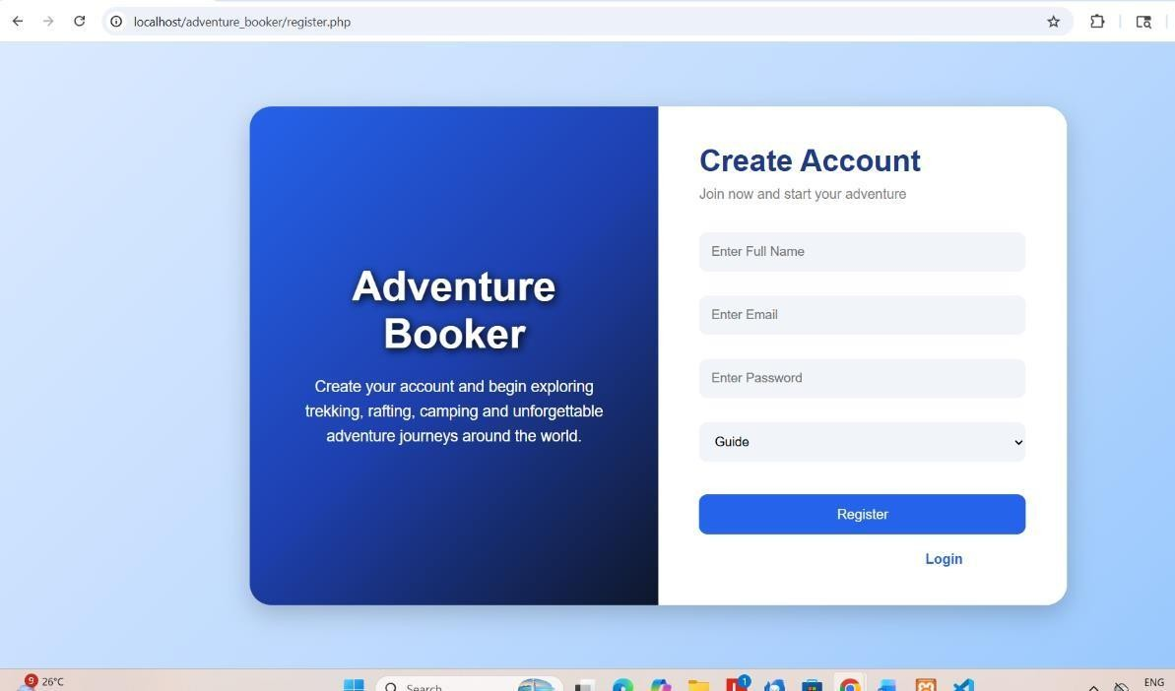
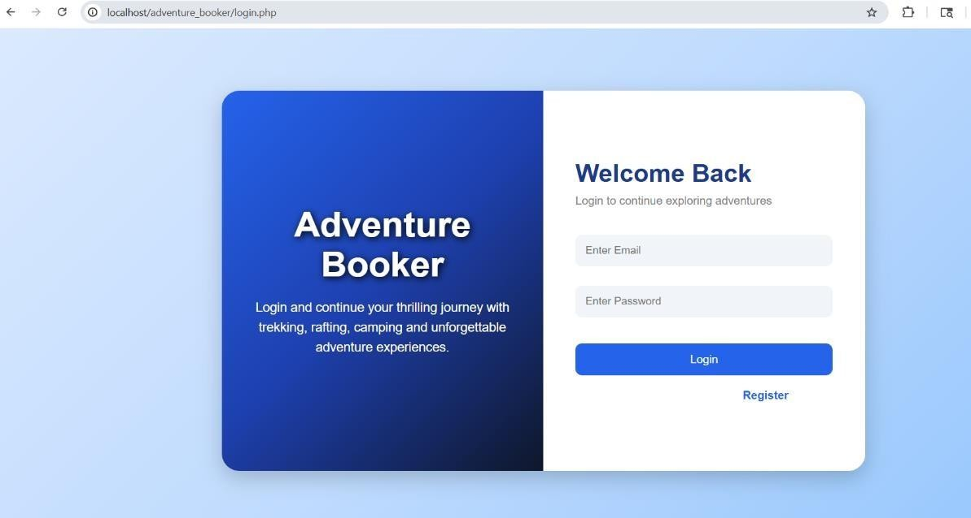
TOUR GUIDE AND ADVENTURE TOURER
CHAPTER 4
RESULT
B24CSL49
4.1 SNAPSHOTS
Fig.4.1: Login Page
Fig.4.2: Register Page

Slide 30
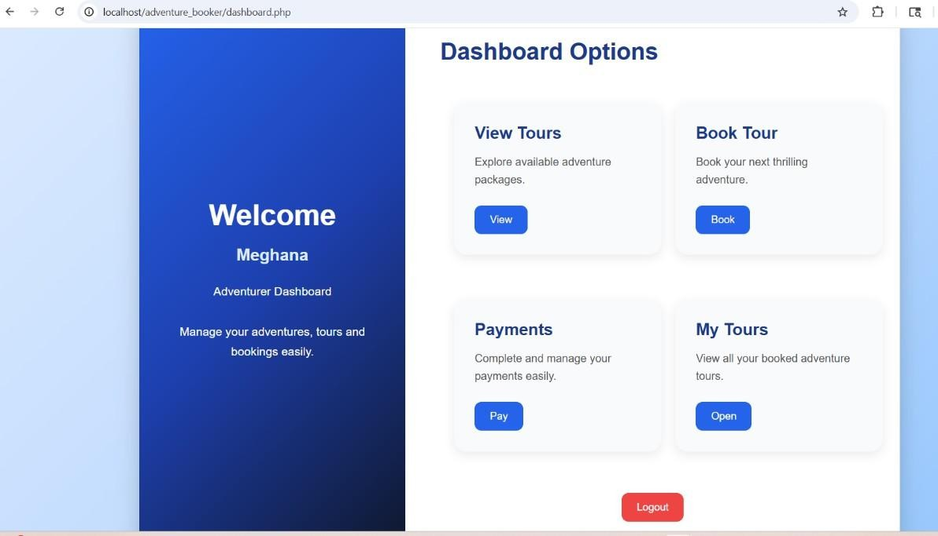
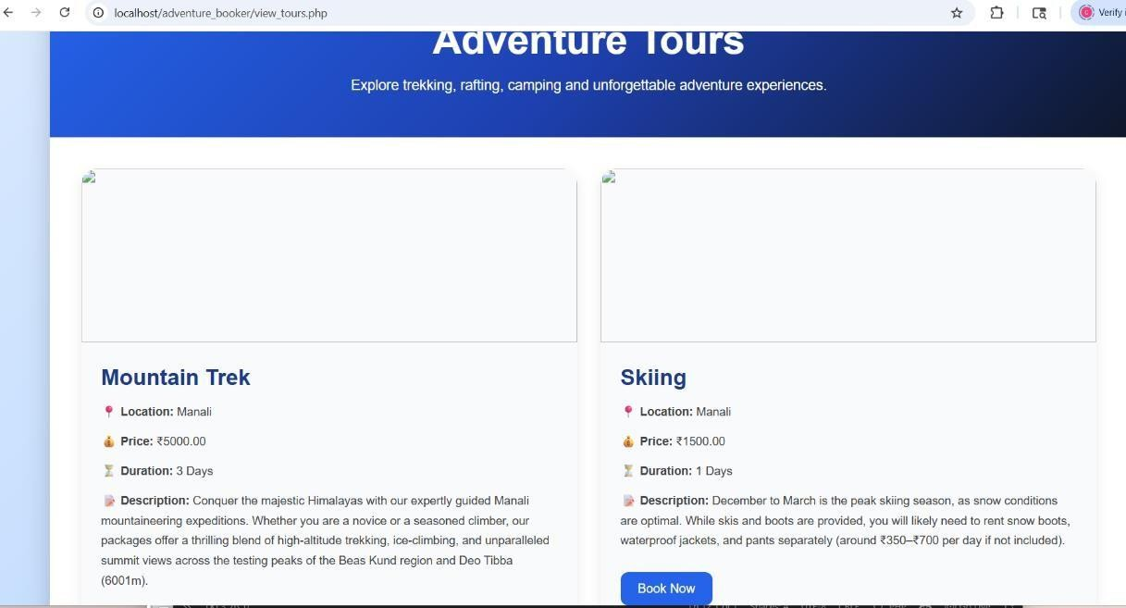
TOUR GUIDE AND ADVENTURE TOURER
B24CSL49
Fig.4.3: Dashboard Page
Fig.4.4: View tour page

Slide 31
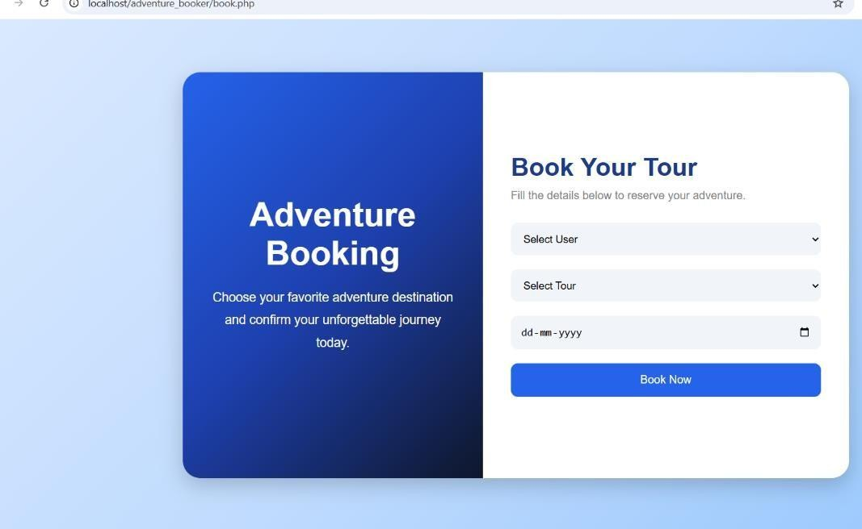
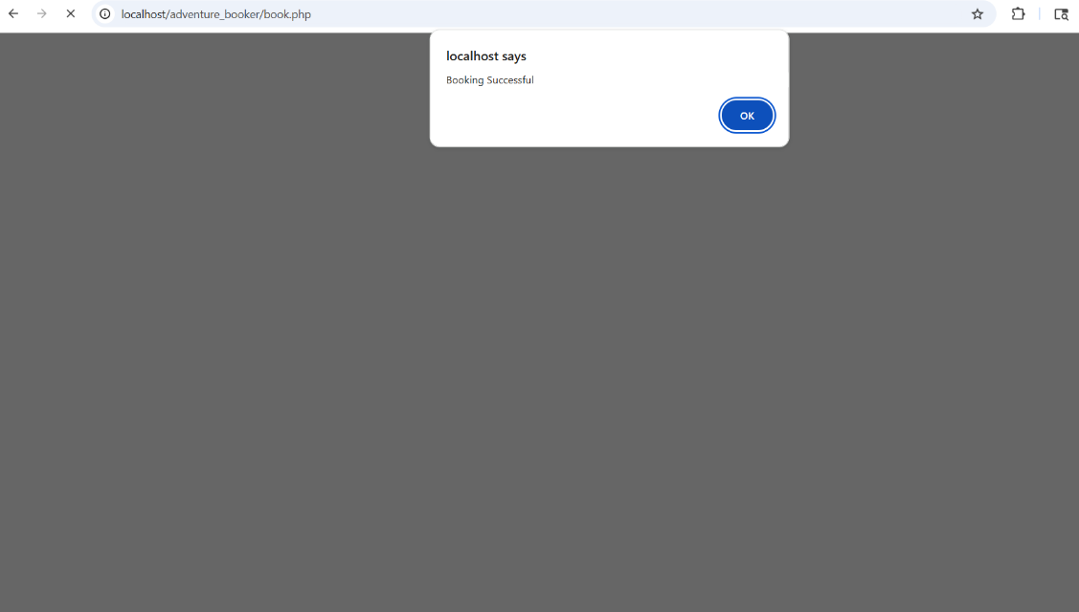
TOUR GUIDE AND ADVENTURE TOURER
B24CSL49
Fig.4.5: Book Tour Page
Fig.4.6: Booking Successful

Slide 32
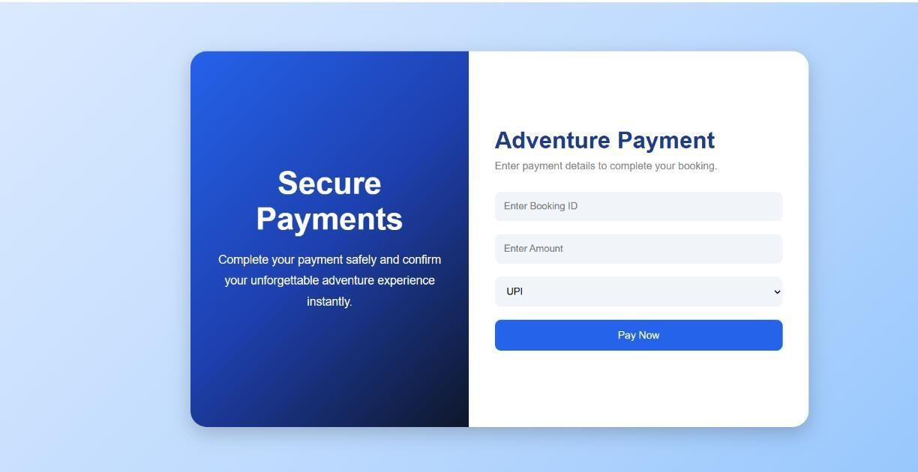
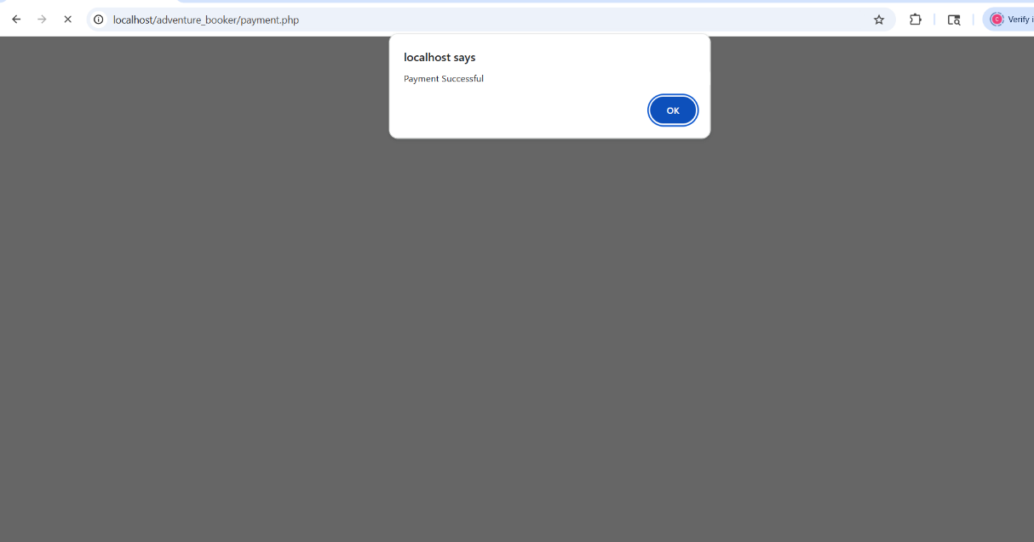
TOUR GUIDE AND ADVENTURE TOURER
B24CSL49
Fig.4.7: Payments
Fig.4.8: Payment Successful

Slide 33
TOUR GUIDE AND ADVENTURE TOURER
B24CSL49
CHAPTER 5
CONCLUSION AND FUTURE ENHANCEMENT
CONCLUSION
The Adventure Booker project is a web-based application designed to simplify the process of booking adventure activities such as trekking, camping, rafting, and other outdoor experiences. The system provides users with an easy-to-use interface to browse available packages, view details, and make bookings efficiently.
This project successfully demonstrates the use of full-stack development concepts along with database management to store and retrieve user and booking information securely. It reduces manual work, eliminates booking confusion, and improves the overall user experience by making adventure trip planning more organized and accessible
FUTURE ENHANCEMENT
Although the current system works effectively, several improvements can be added in the future to enhance its functionality:
Mobile Application Development: A dedicated Android/iOS app can be developed for better accessibility and user
Online Payment Integration
User Reviews and Ratings convenience: Secure payment gateways like UPI, Razorpay, or PayPal can be added for instant booking confirmation. Users can be allowed to rate and review adventure packages to help others make better decisions.

Slide 34
TOUR GUIDE AND ADVENTURE TOURER B24CSL49
Al-based Recommendations:The system can suggest adventure packages based on user
preferences and past bookings.A chatbot or customer support chat feature can be added for instant assistance.
Live Chat Support
GPS and Location Tracking:Real-time tracking for adventure locations and guides can improve safety and experience.
Advanced Admin Dashboard: More detailed analytics like booking trends, revenue reports, and user activity tracking can be included.

Slide 35
TOUR GUIDE AND ADVENTURE TOURER
REFFERENCES
B24CSL49
Ramez Elmasri and Shamkant B. Navathe, "Fundamentals of Database Systems", 7th Edition, Pearson Education, 2016.
W3Schools SQL & PHP Tutorial — https://www.w3schools.com/sql/ and https://www.w3schools.com/php/
MySQL 8.0 Reference Manual — https://dev.mysql.com/doc/refman/8.0/en/ 4] MySQL Workbench Manual — https://dev.mysql.com/doc/workbench/en/
5] XAMPP Documentation — https://www.apachefriends.org/documentation.html 6] GeeksforGeeks DBMS Tutorials — https://www.geeksforgeeks.org/dbms/
7] Claude AI — https://claude.ai 8] ChatGPT — https://chatgpt.com

